Slide 1
Goals and Quarterly Feedback
Starting April 1, 2021 we will be entering our quarterly feedback into Workday. Our first period to enter will be FY20 Q3 (Jan, Feb, March 2021)

Slide 3
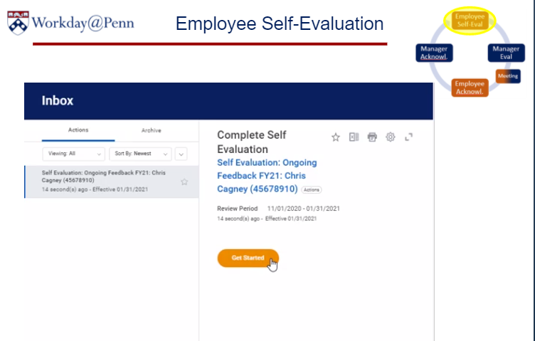

Slide 5
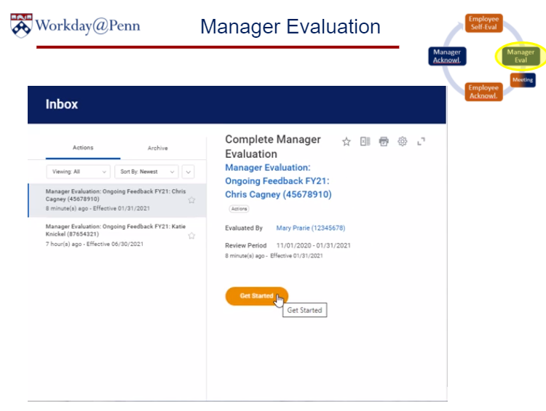

Slide 7
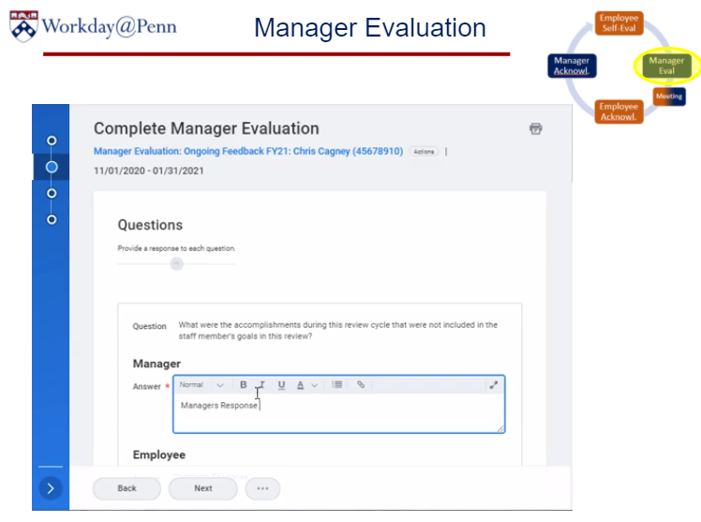
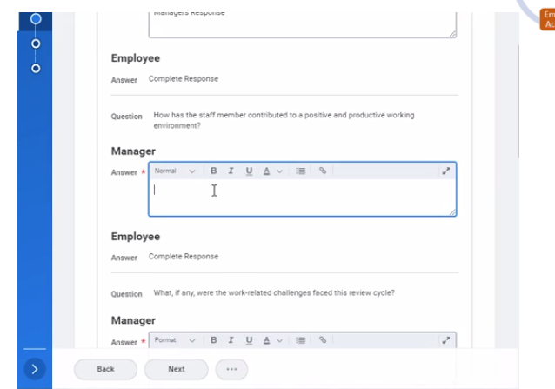

Slide 9
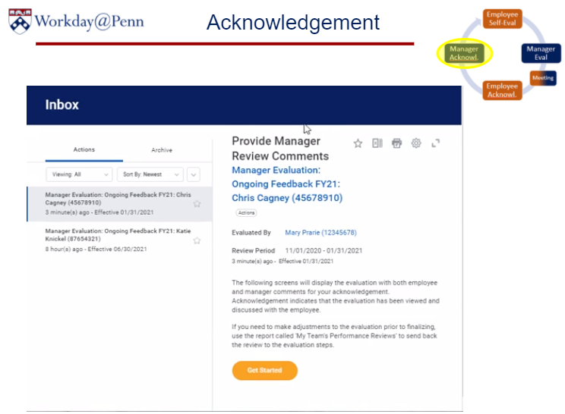

Slide 10
Questions?

